Slide 1

Physics-Based Distributed Collaborative Design for Aerospace Vehicle Development and Technology Assessment
Phoenix Integration
2018 International Users’ Conference
April 17-19, 2018
Ray Kolonay PhD
Director – Multidisciplinary Science & Technology Center
US Air Force Research Lab

Slide 2
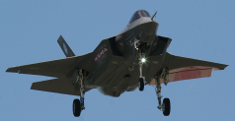
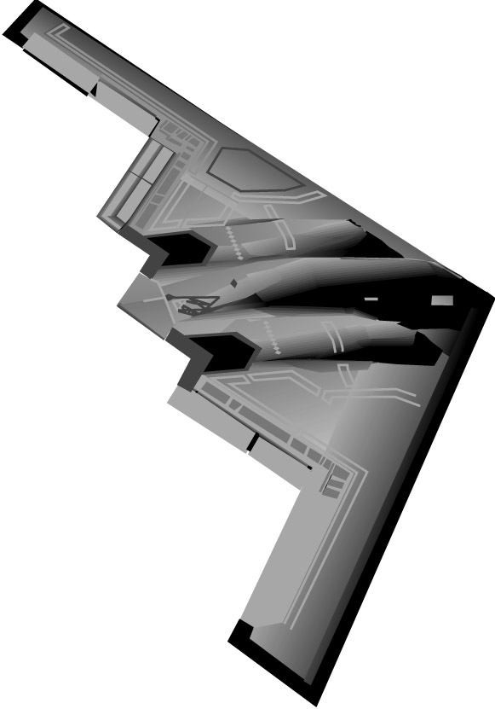
Reducing the Knowledge Deficit in Capability Prediction
100%
Proposed Process
Today’s Process
Confidence in Capability Prediction
Remove Knowledge deficit via via MSTC methods & processes
10%
Milestone A
Milestone B
Milestone C
IOC
1 cost unit
Time & Cost of Defect Correction
1000 cost units
Approved for public release 88ABW-2015-3206 CLEARED on 24 Jun 2015

Slide 3
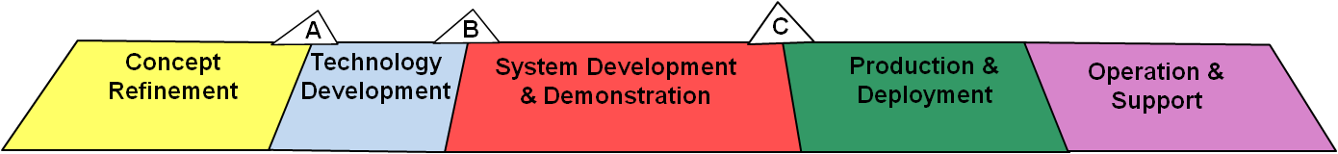
Cost & Capability versus Life Cycle
70% -75 % LCC locked in
28% LCC Incurred
72% LCC Incurred
Min Knowledge Max Cost Impact
(Increase Knowledge with high fidelity coupled Physics)
1000
Cost of error
correction
1
4x
+
-
Cost Over run
Baseline Unit Cost
Pre-Milestone A –
Increase disciplines, fidelity, and MD coupling
Reduce LC Cost over run
Reduce LC Capability Degradation
+
-
Baseline Capability
-xX
Capability Degradation
Driving High Fidelity Physics Based Design Early in the Process Produces More Capability & Lower Cost Over Life Cycle (“Bend the Cost Curve”)
*Extracted from Pre-Milestone A and Early-Phase Systems Engineering: A Retrospective Review and Benefits for Future Air Force Acquisition 2008
*Extracted from Pre-Milestone A and Early-Phase Systems Engineering: A Retrospective Review and Benefits for Future Air Force Acquisition 2008
Approved for public release 88ABW-2015-3206 CLEARED on 24 Jun 2015
Notes:
*Extracted from Pre-Milestone A and Early-Phase Systems Engineering: A Retrospective Review and Benefits for Future Air Force Acquisition 2008

Slide 4
Goals
Deliver vehicles that satisfy mission requirements in a timely manner
Reduce the number of late defects due to modeled physics
Trace technology to mission level capability impact based on physics
Approved for Public Release 13 Aug 2013 - 88ABW-2013-3606

Slide 5
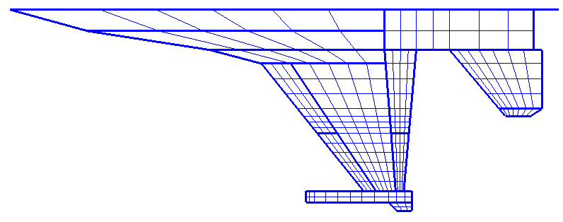
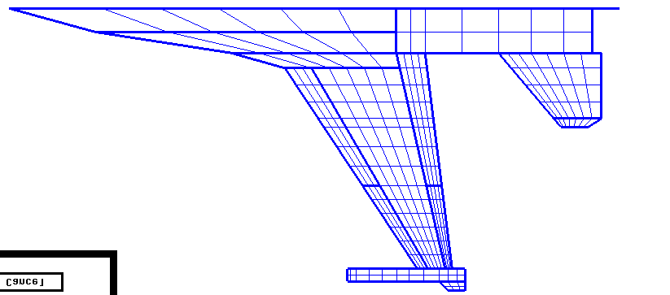
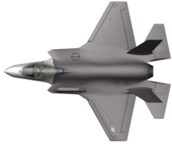


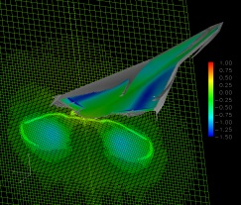
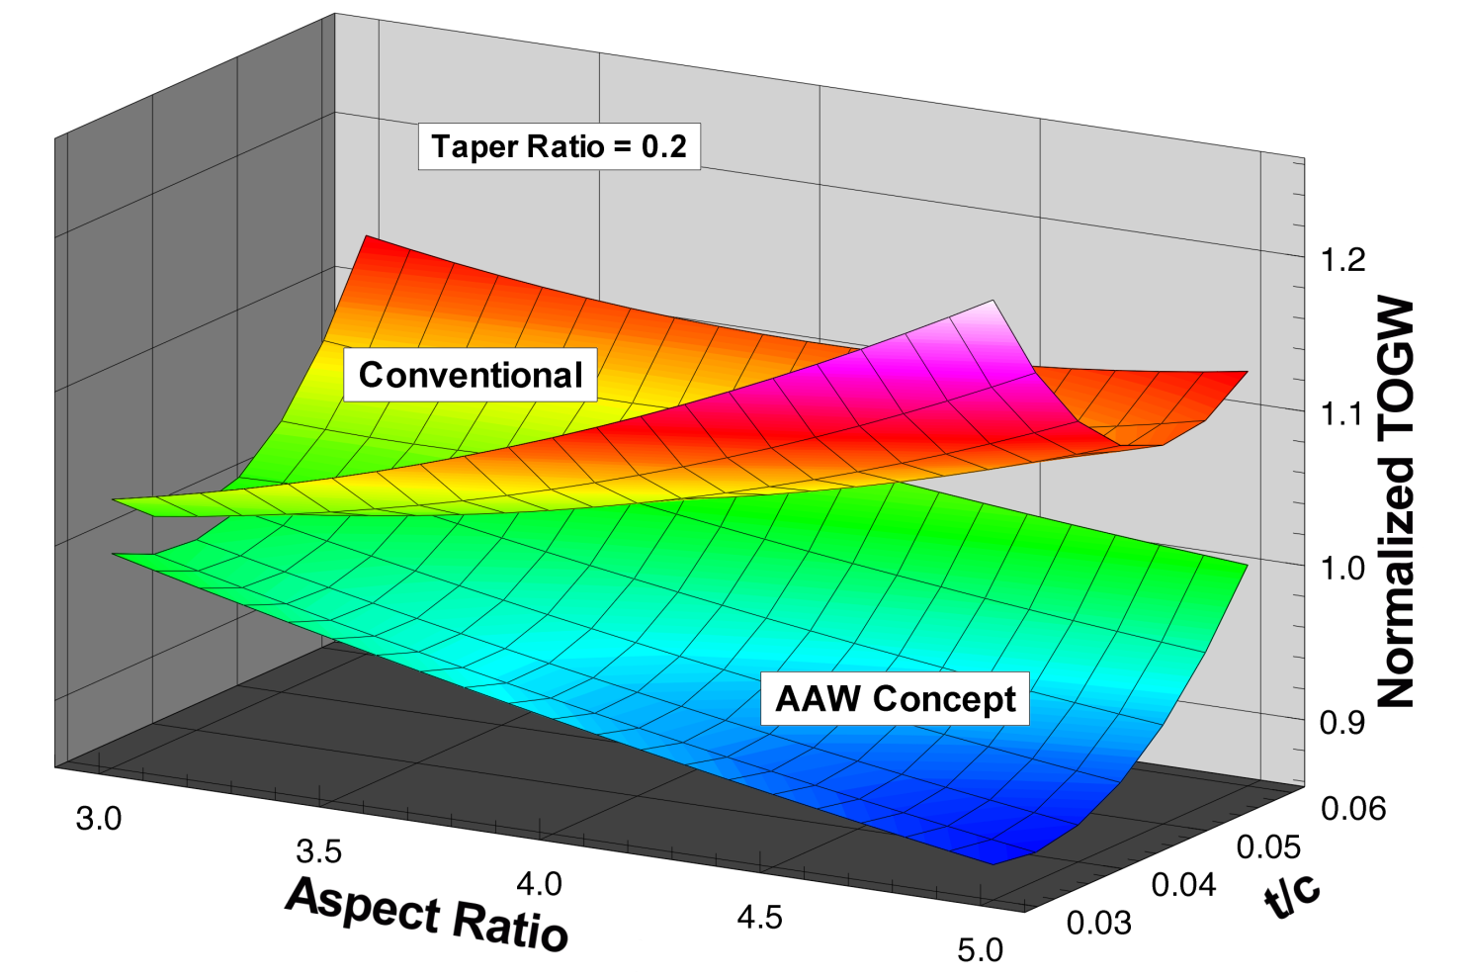


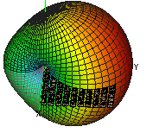
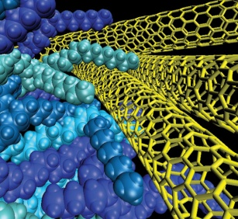
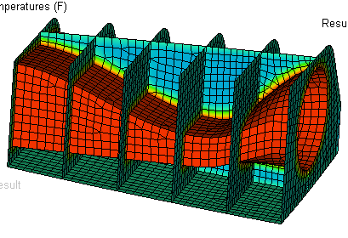
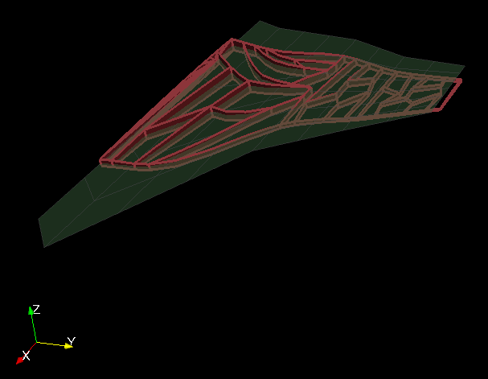
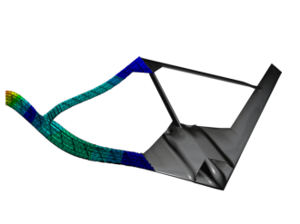
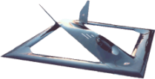
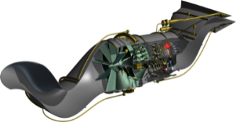



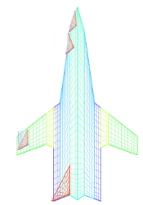
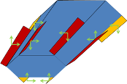
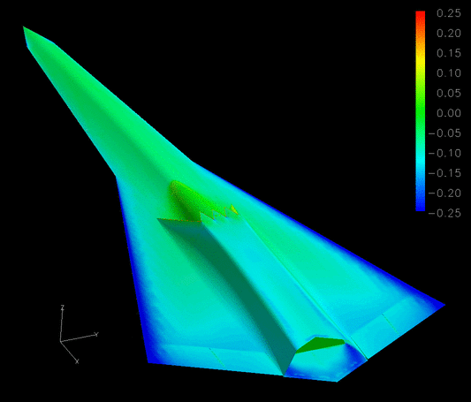

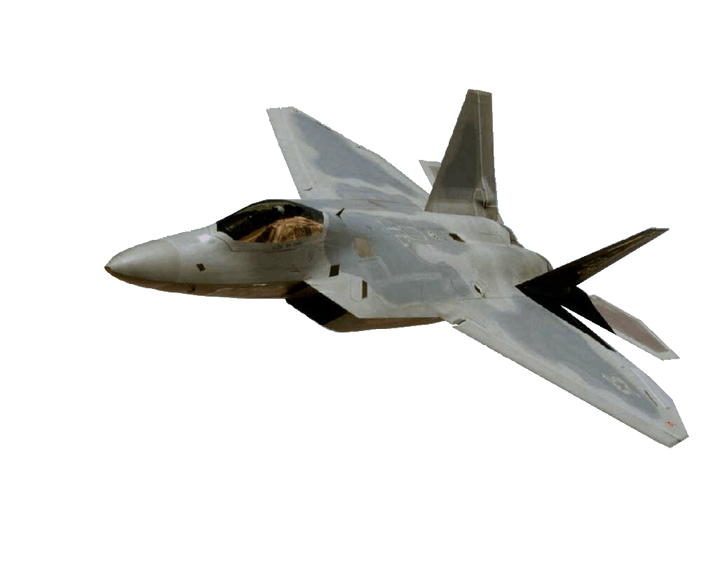
Develop & Trace Technology to Mission Level Capability Impact Based on Physics
Technology
Mission Capability Impact
Aeroelastic Wing
Flutter Suppression
Third Stream Engine
Advanced Materials
Thrust Vectoring
Innovative Control Effectors
Directed Energy
Conformal Load Bearing Antennas
…
…
  Combat effectiveness
  Survivability
    Kills/$
    IDs/$
    Mantainability
    Life Cycle Cost
    Sustainability
    …
Engineering Capability Impact
Weight Reduction
Drag Reduction
RCS reduction
Fuel Efficiency
Roll Performance
Radar Efficiency
…
Space Based
Want to find: $\frac{∂Mission_Capability}{∂Technology}$
Approved for public release 88ABW-2015-3206 CLEARED on 24 Jun 2015

Slide 6
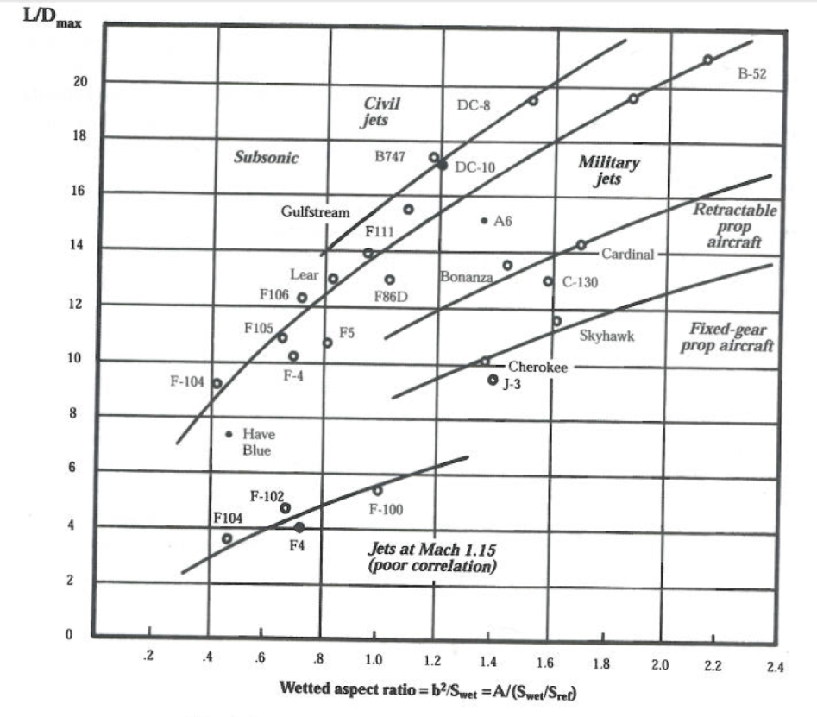
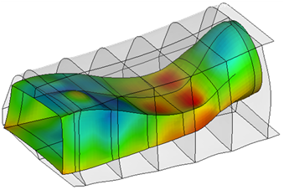
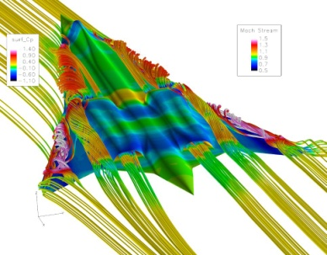
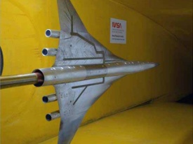
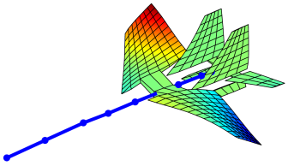
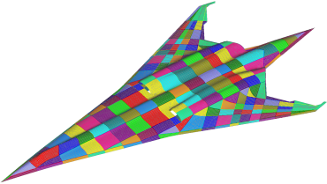

What we mean by “Physics Based”
Regressions of historical Data
Computational or testing on actual configuration
Versus
Raymer
Historical data insufficient for designing new/innovative configurations and assessing new technologies
Approved for public release 88ABW-2015-3206 CLEARED on 24 Jun 2015
Notes:
K_dw = 0.76 for delta wing 1.0 Otherwise
K_vs = 1.19 for variable sweep 1.0 Otherwise
W_dg – flight design gross weight in lb
N_z – ultimate load factor
S_w Trapezoidal wing area
A – aspect ratio
Lower case lambda – taper ratio
S_csw – control surface area

Slide 7

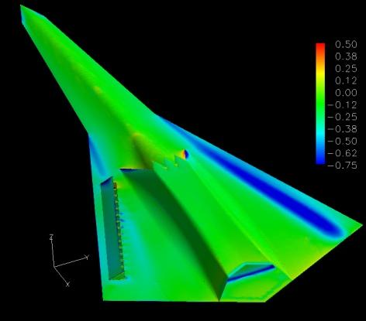
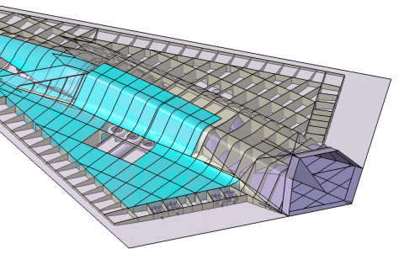
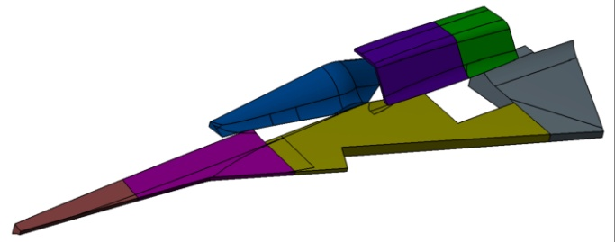
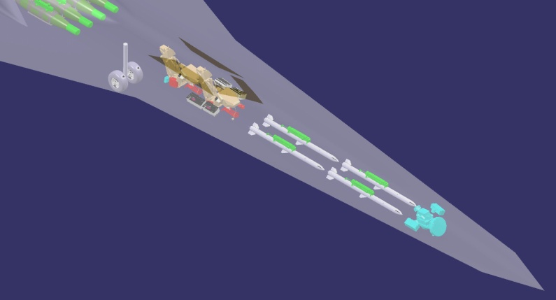
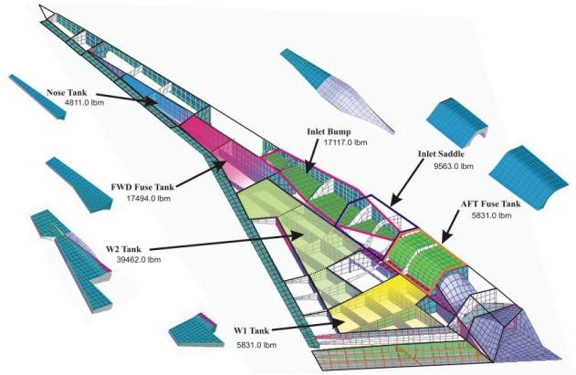
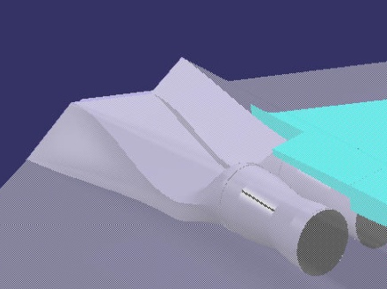
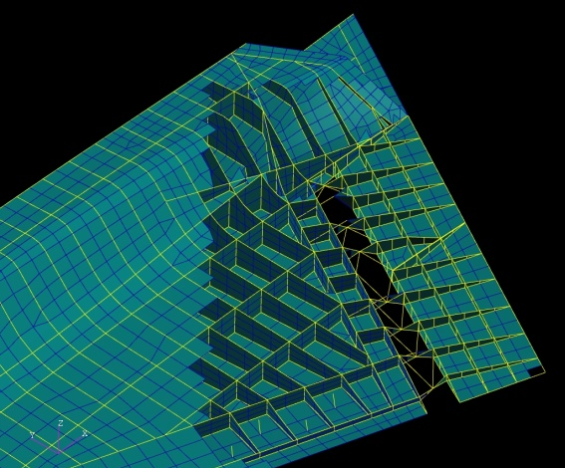
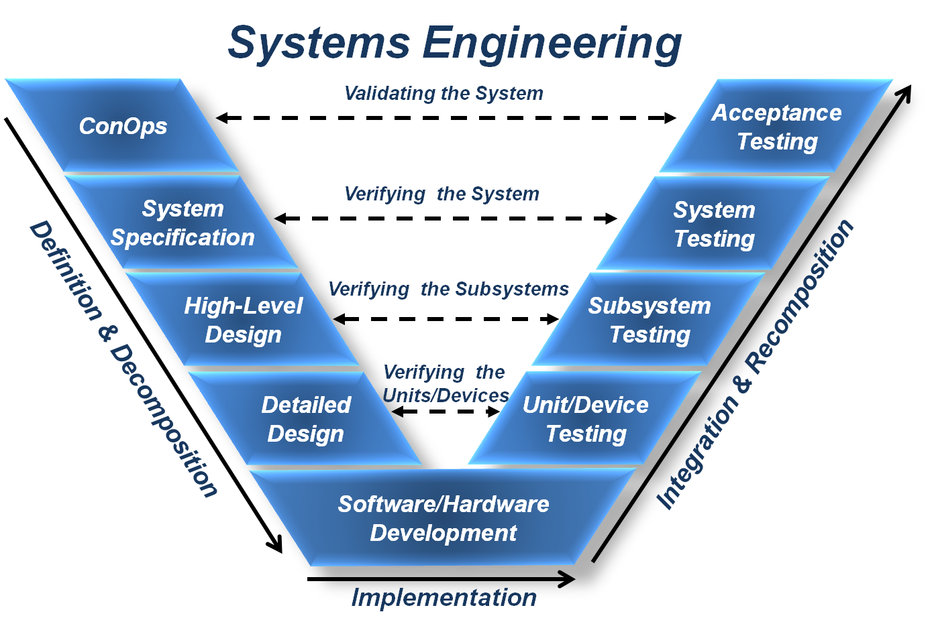
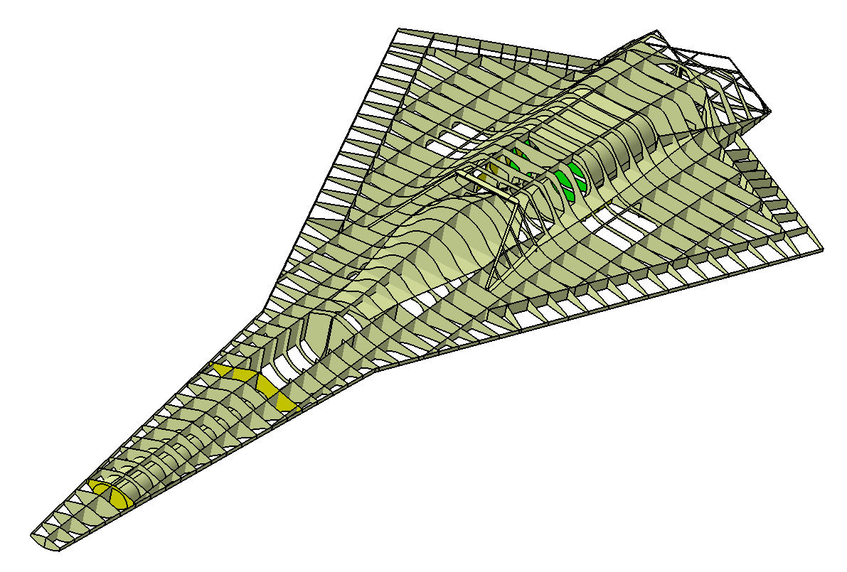
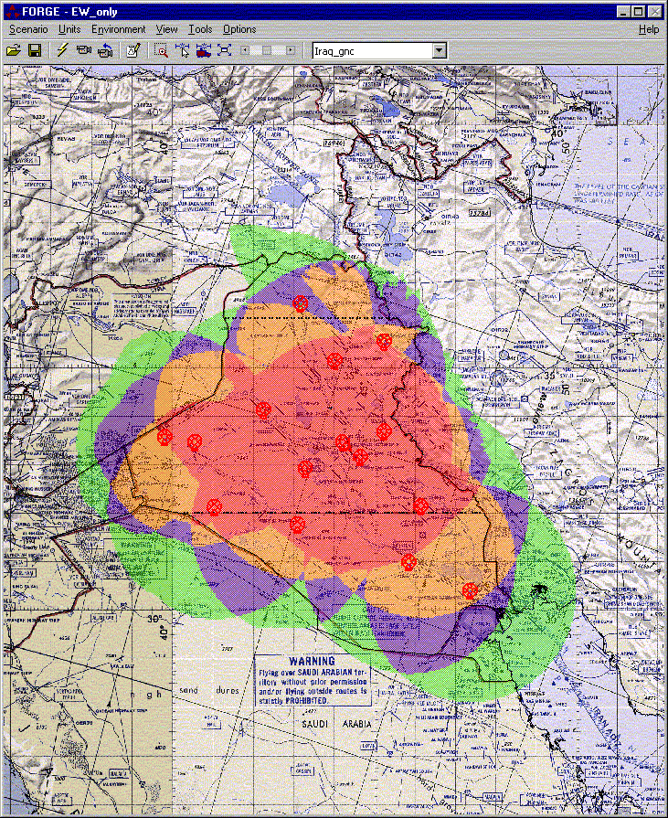
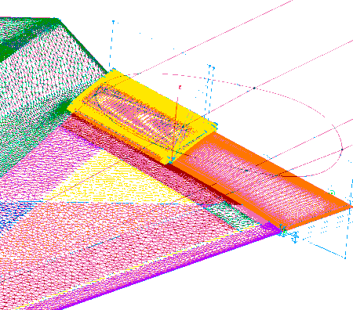
MSTC Design Process Goals
(System Level Multi-Fidelity MADO)
Merge Conceptual & Preliminary Design
Subsystems & fuel management
Aerodynamics
EEWS
System Thermal Management
$
Cost
Propulsion
Con Ops &
System Spec.
Structures
Mission Effectiveness
Stability & Control
Add Disciplines, Couplings, & Fidelity - Early
Approved for public release 88ABW-2015-3206 CLEARED on 24 Jun 2015

Slide 8
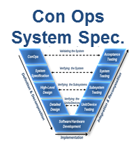
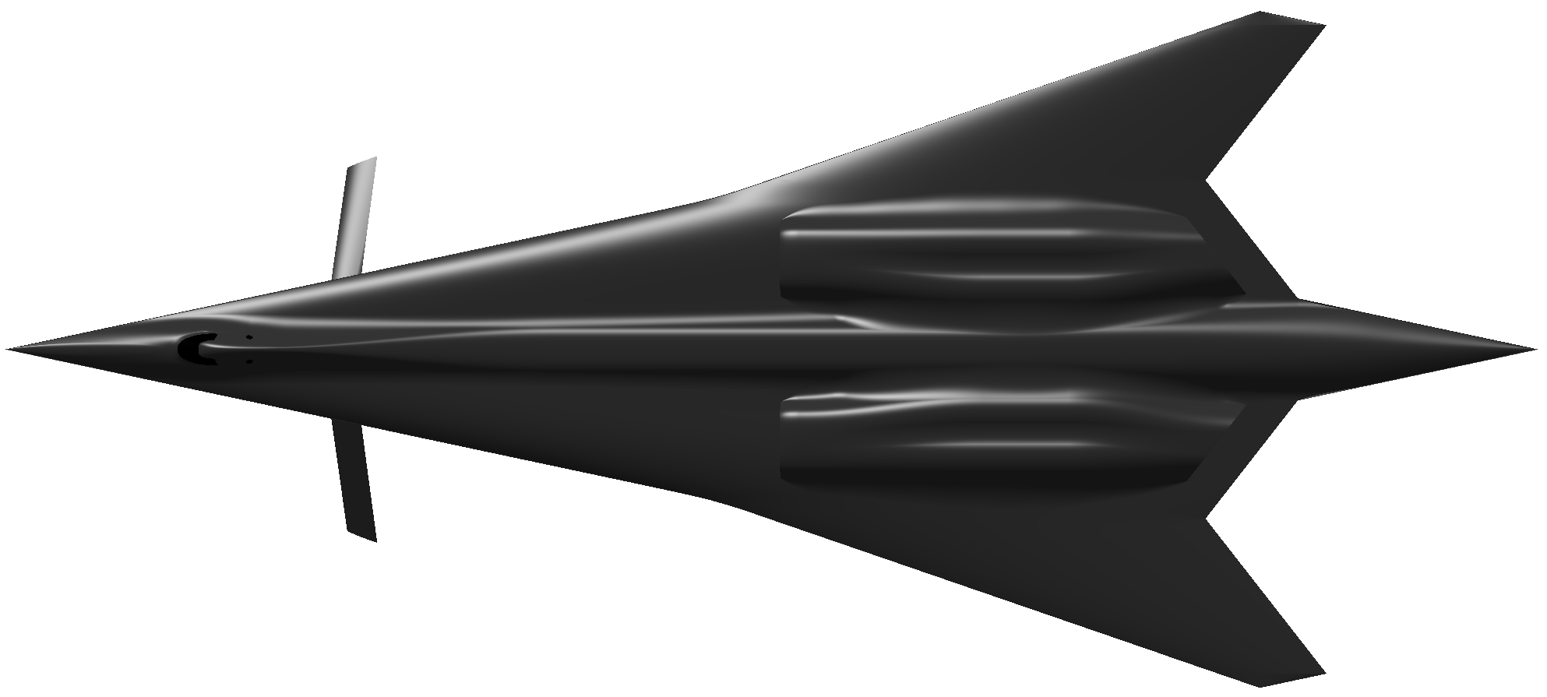
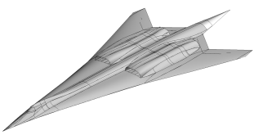

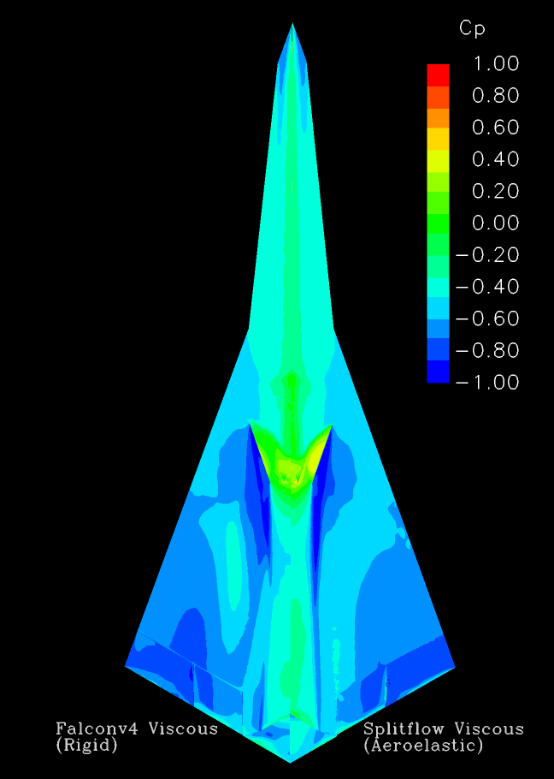
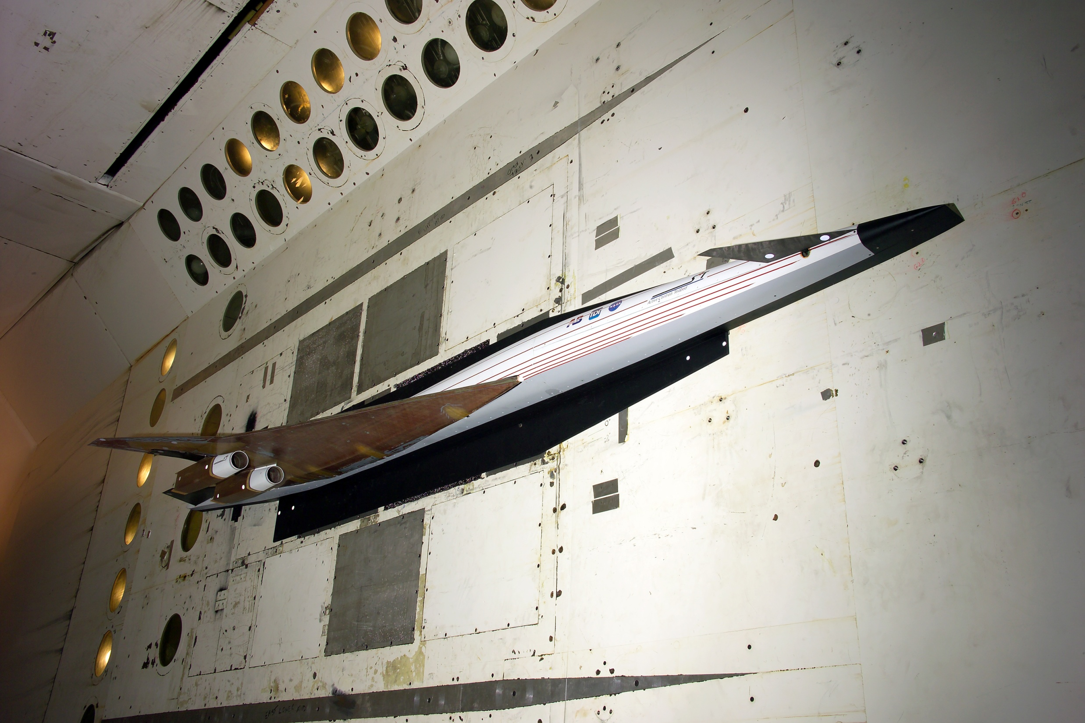
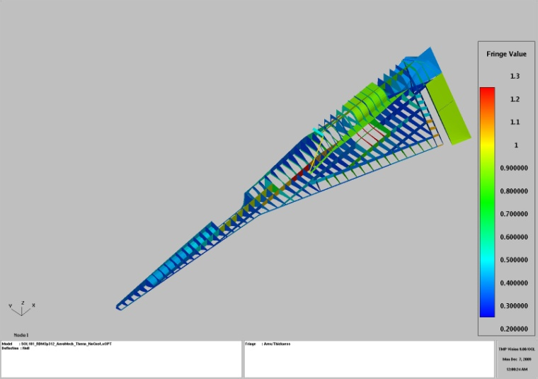
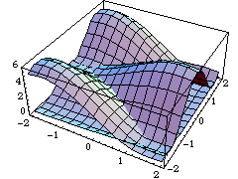
How to Capture the Physics Driving the Design Pre-Milestone A
1000s configurations
Technology
Suite
Conceptual Design Studies
Physics Based
Design & Assessment
Modeling for Design
Methods Application &
Technology Validation
Prototype
Experimental
Validation
Multi-Fidelity Analysis for Design
Design Space Exploration
Get more (and Better) Information … and get it Earlier
Approved for public release 88ABW-2015-3206 CLEARED on 24 Jun 2015
8

Slide 9
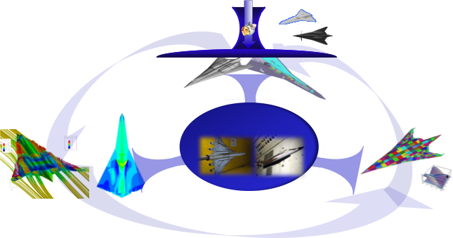
Gaps to Achieving Desired Process
Need rapid development of domain model construction from geometry (structural lay-outs, configurations, FEM, CFD Meshes, sub-systems etc..)
Need coupling of all necessary engineering disciplines (structures, aero, thermal, controls, acoustics etc..) at the necessary level of fidelity to predict static and dynamic responses
Computational framework that supports hi-fidelity distributed collaborative design.
Synthesis process does not currently include uncertainty & probabilistic design methods
Culture
Need to be able to do 10’s of HiFi Physics Based Configuration Design with the Same Resources & Time of Traditional Conceptual Design
Approved for Public Release 13 Aug 2013 - 88ABW-2013-3606

Slide 10
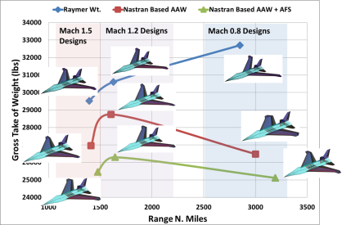
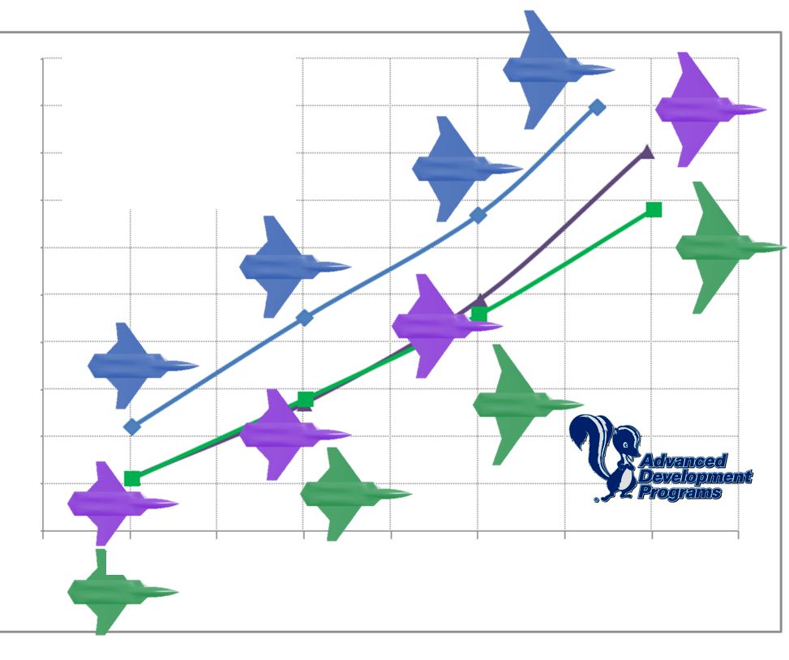

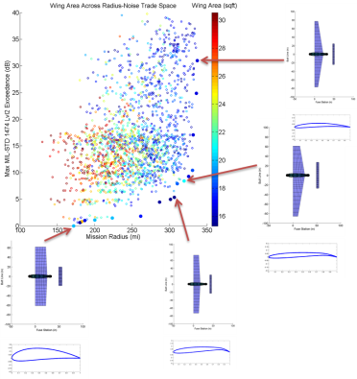

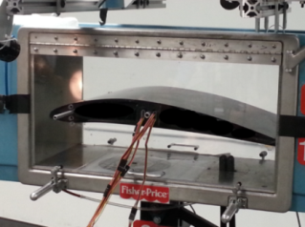
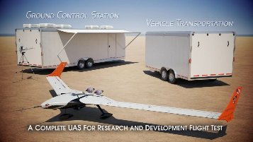
MADO N³ Diagram
(aka design structure matrix, dependency structure matrix, spider diagram)
MSTC Develops, Executes & Validates
Configuration
Parametric Associative Geometry & Discretization
Propulsion
Thrust, SFC
Mass Properties
Raymer Weights
Aeroelasticity
Linear
Structures
Linear FEM Based
Aero(NS))
Rigid Loads & Drag
Aero(Euler))
Rigid Loads & Drag
Heat Transfer
S&C
Surface Effectiveness Control Pwr. Req
Aero(Linear Potential)
Rigid Loads & Drag
Aero(Empirical)
Rigid Loads & Drag
Aero
Rigid Loads & Drag
MADO Development (populate the N²)
Add Disciplines & their Sensitivities (diagonals)
Add Chained and Coupled Analysis (connections)
Add Fidelity (depth)
Aero Acoustics
Exhaust Wash, Wing shielding & propagation
System Thermal Management/Balance
Distribute N³
MADO Studies & Technology Assessment(Execute N²)
Select appropriate Disciplines, Couplings, Fidelities
Formulate Optimization Problem
Execute N³
Discipline x
Mission Performance
Operations Analysis
Constructive with Physics based models
Need a Computational Environment to Achieve BCA MADO
MD Technology Validation (Validate results of N² Execution)
Ground, Wind tunnel & Flight Experiments
Need to Maximize Reuse
Optimization
Approved for public release 88ABW-2015-3206 CLEARED on 24 Jun 2015

Slide 11
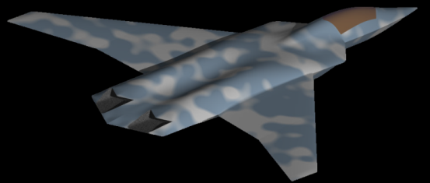
















Typical Target Application
Efficient Supersonic Configuration
Effectiveness Objectives
Access, Firepower, Reach, Speed/Agility
Engineering Objectives
Range, Weight, Specific Excess Power
Design Variables
Aerodynamic (10’s)
Controls (10’s)
Engine (10’s)
Subsystems(100’s)
Structural (1000’s)
Constraints
Strength, Stiffness, Thermal
Static and Dynamic Aeroelastic
Level 1-3 Fidelity
Technology Evaluations
Configuration
Compact Weapons, Compact Launchers
Aerodynamics
Subsonic Laminar Flow , Supersonic Laminar Flow
Propulsion
Variable Cycle Engine
Advanced High Speed Inlet
Structures
Active Aeroelastic Wing Active Flutter Suppression
S & C
ICE Effectors (SSD)
Approved for public release 88ABW-2015-3206 CLEARED on 24 Jun 2015

Slide 12
MSTC High Level Requirements for System Level MADO (MDMFMSAOwUQ)
# of components/applications/Services – 100’s to 1000’s
Run times of services – secs to weeks
Data
  kilobytes to terabytes
  ascii, binary, databases
Distributed (across organizational boundaries) heterogeneous computing environment
  Hand held devices to HPC resources
  Seamless access to data and services
  Process representation with secure communications
1E4 of design variables
1E5 constraints
Multi-Objective
Approved for public release 88ABW-2015-3206 CLEARED on 24 Jun 2015

Slide 13



Physics Based Distributed Collaborative Design (Compute Resource View)
Working with ERS-ERDC to enable
High Fidelity Physics
HPC
Engineering/High Fidelity
Clusters
Empirical/Engineering
Desktops
Current MSTC Capability
Seamless Access to All Methods, Models, Data, and Compute Resources Across the Network
Approved for Public Release 13 Aug 2013 - 88ABW-2013-3606

Slide 14













Physics Based Distributed Collaborative Design (Org View)
Good “Community Members” Publish Information for Collaborators
We are silos and there is a good reason to keep it that way
Flight Control
Rocket
Propulsion
Design Study X
Turbine
Engine
Aerospace
Structures
Vehicle
Aerodynamics
People, Tech.,
Data, & Tools
As Needed Real Time Access to Applications & Data by ALL Communities
Distributed Collaborative Design!
Aerospace
Propulsion
Approved for Public Release 13 Aug 2013 - 88ABW-2013-3606
Power

Slide 15











Impact
Scientific Impact
Acquisition Impact
Past
Reduce discovery of late defects due to un-modeled physics
Exploiting the synergism of mutually interacting phenomena to produce a capability that cannot be obtained otherwise
Future
Multi-disciplinary Science is an enabler for the development of the next generation air and space vehicles
It is essential to determine early on the pertinent interactions between coupled engineering disciplines
It is essential to determine early on the pertinent interactions between competing engineering disciplines
Approved for public release 88ABW-2015-3206 CLEARED on 24 Jun 2015
Notes:
X-29 – aeroelastic tailoring, quad redundant control
X-53 – couples aero, structures, and controls

Slide 16













Impact on Efficient Supersonic Air Vehicle Design & Technology Assessment
= 0.6% Empty Wt
Using traditional Level 0 Conceptual Design
- Active flutter suppression benefit 0.6% Empty Wt
0th order fidelity
Increasing Physics Disciplines & Coupling has a Significant Impact on the Resulting Vehicle Configuration, Performance, & Technology Impact
Approved for Public Release 13 Aug 2013 - 88ABW-2013-3606

Slide 17



Concluding Remarks
Historical data & traditional conceptual design processes are insufficient for designing new/innovative configurations and technologies
A physics-based distributed collaborative design Environment for aerospace vehicle development and technology assessment has been developed (leverages MSTC Engineering)
Enables 10’s of HiFi Physics Based Configuration Design with the Same Resources & Time of Traditional Design evaluates 1 or 2.
Enables AFRL technology developers to have a quantifiable, physics based and traceable trail of the impact of their technologies on system effectiveness – lethality, survivability, sustainability, affordability etc...
Creates info. with less uncertainty for making decisions for system capabilities, technology assessment, and technology risk reduction
Reduction of late Defects due to physics
Expanded design space yielding capabilities not other wise obtainable
Approved for Public Release 13 Aug 2013 - 88ABW-2013-3606

